Slide 1
September 2023 release of Power BI apps on telemetry
Dynamics 365 Business Central

Slide 2
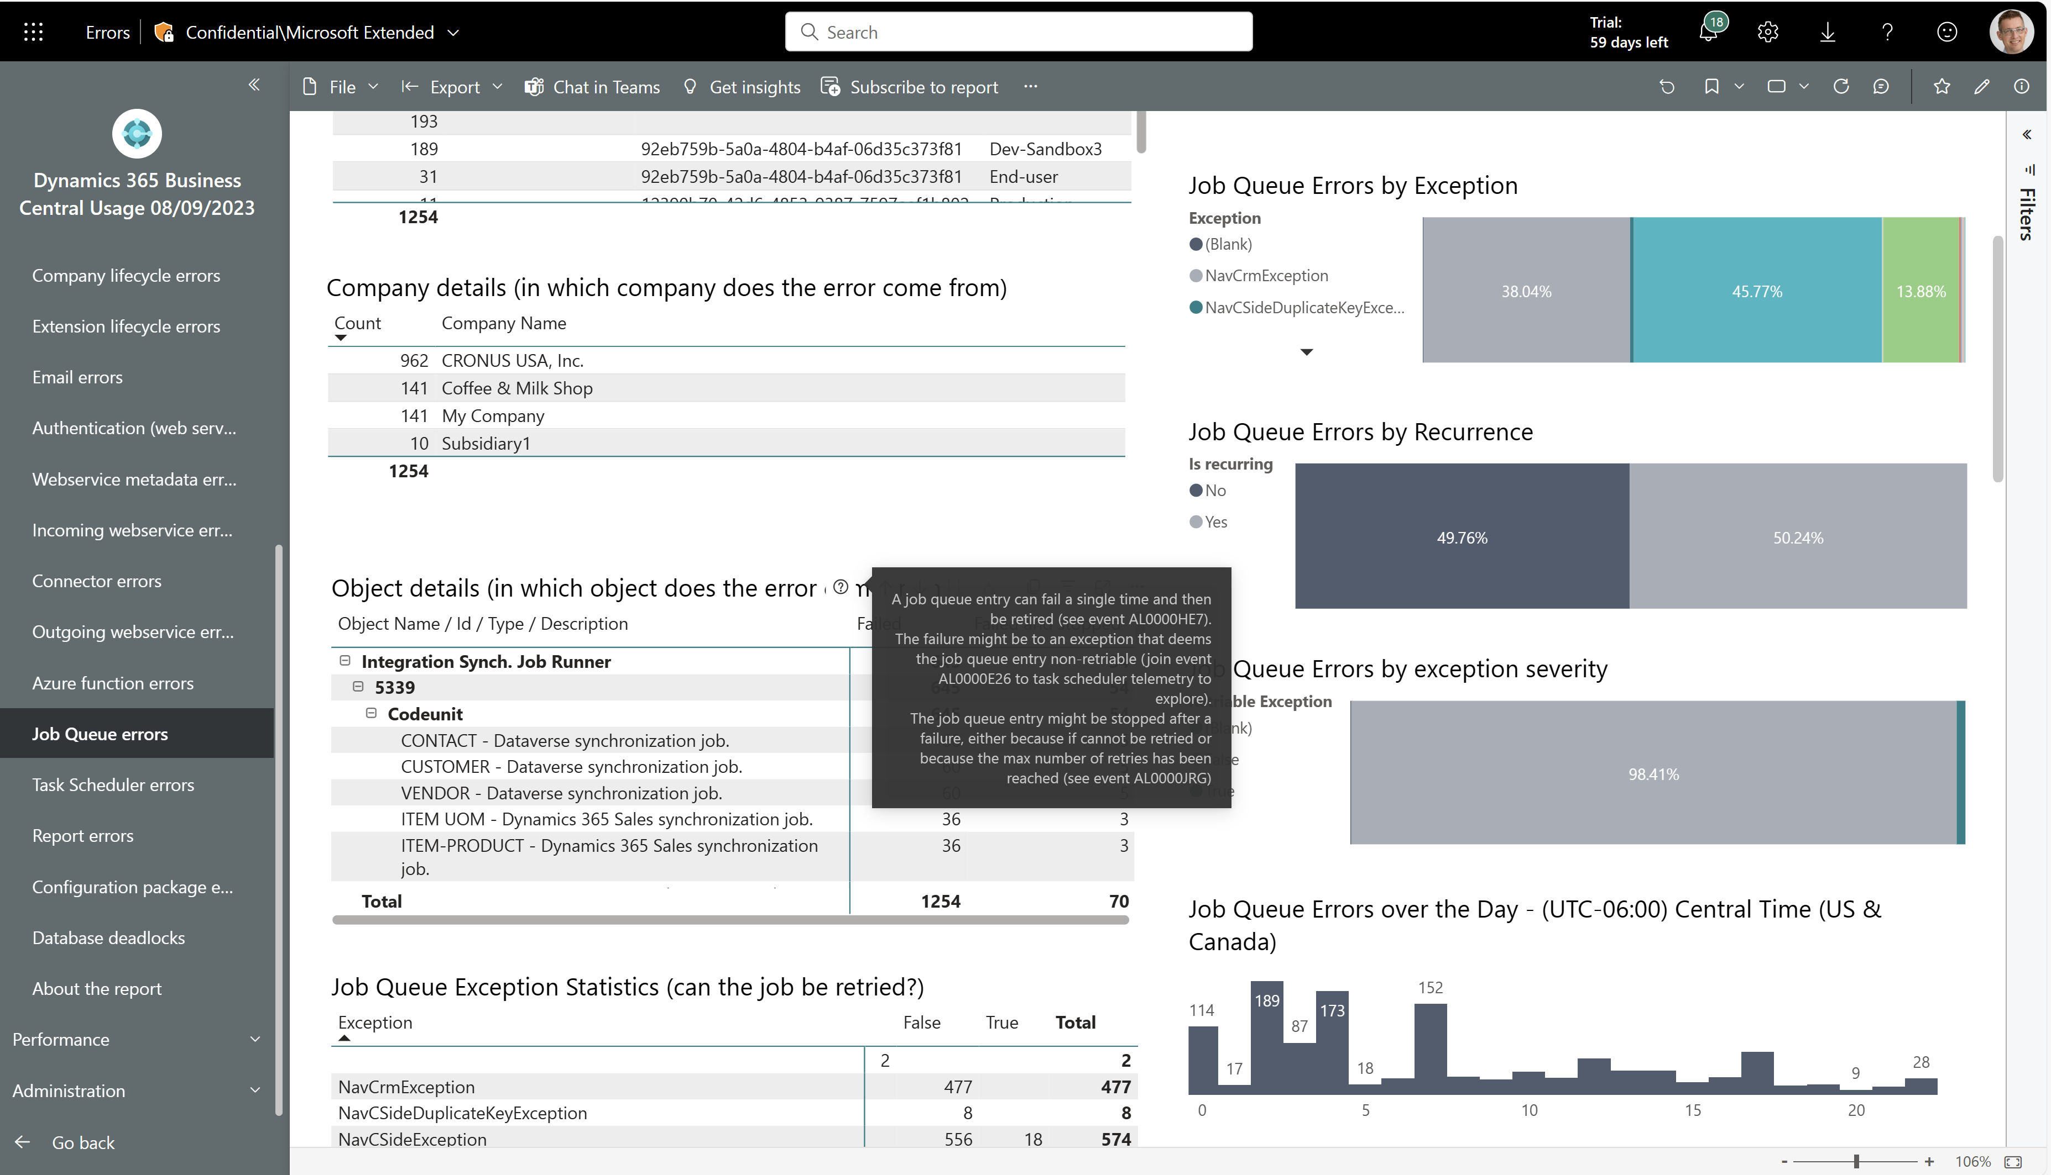
Job queue errors: Now shows job queue entries that are stopped by the platfom
Find job queue entries that repeatably fail and are then stopped by the platform

Slide 3
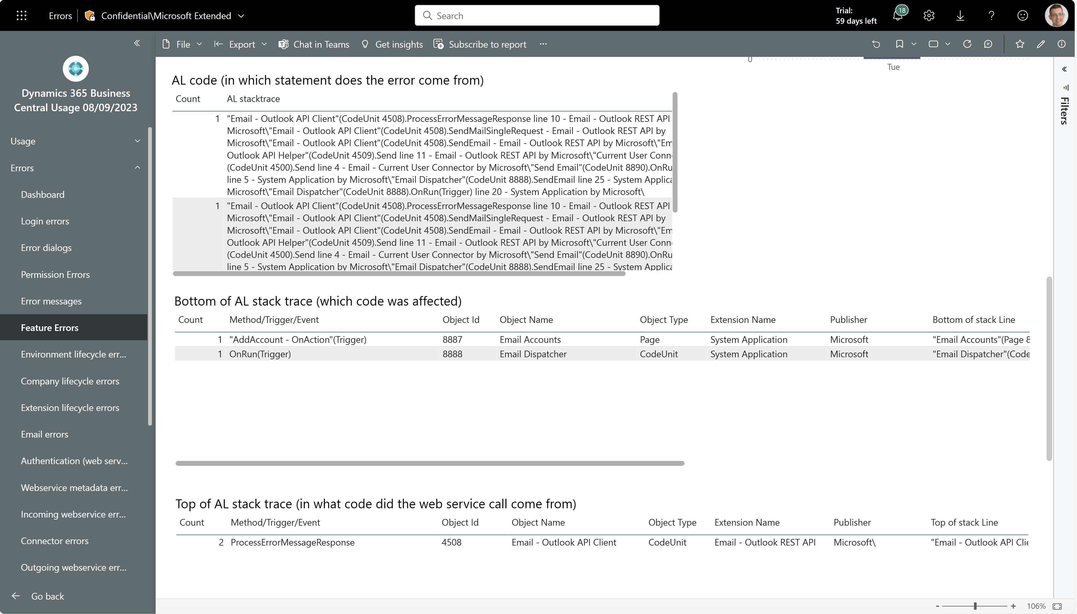
Easier troubleshooting of feature errors
Feature errors now also show top/bottom of AL stacktrace

Slide 4
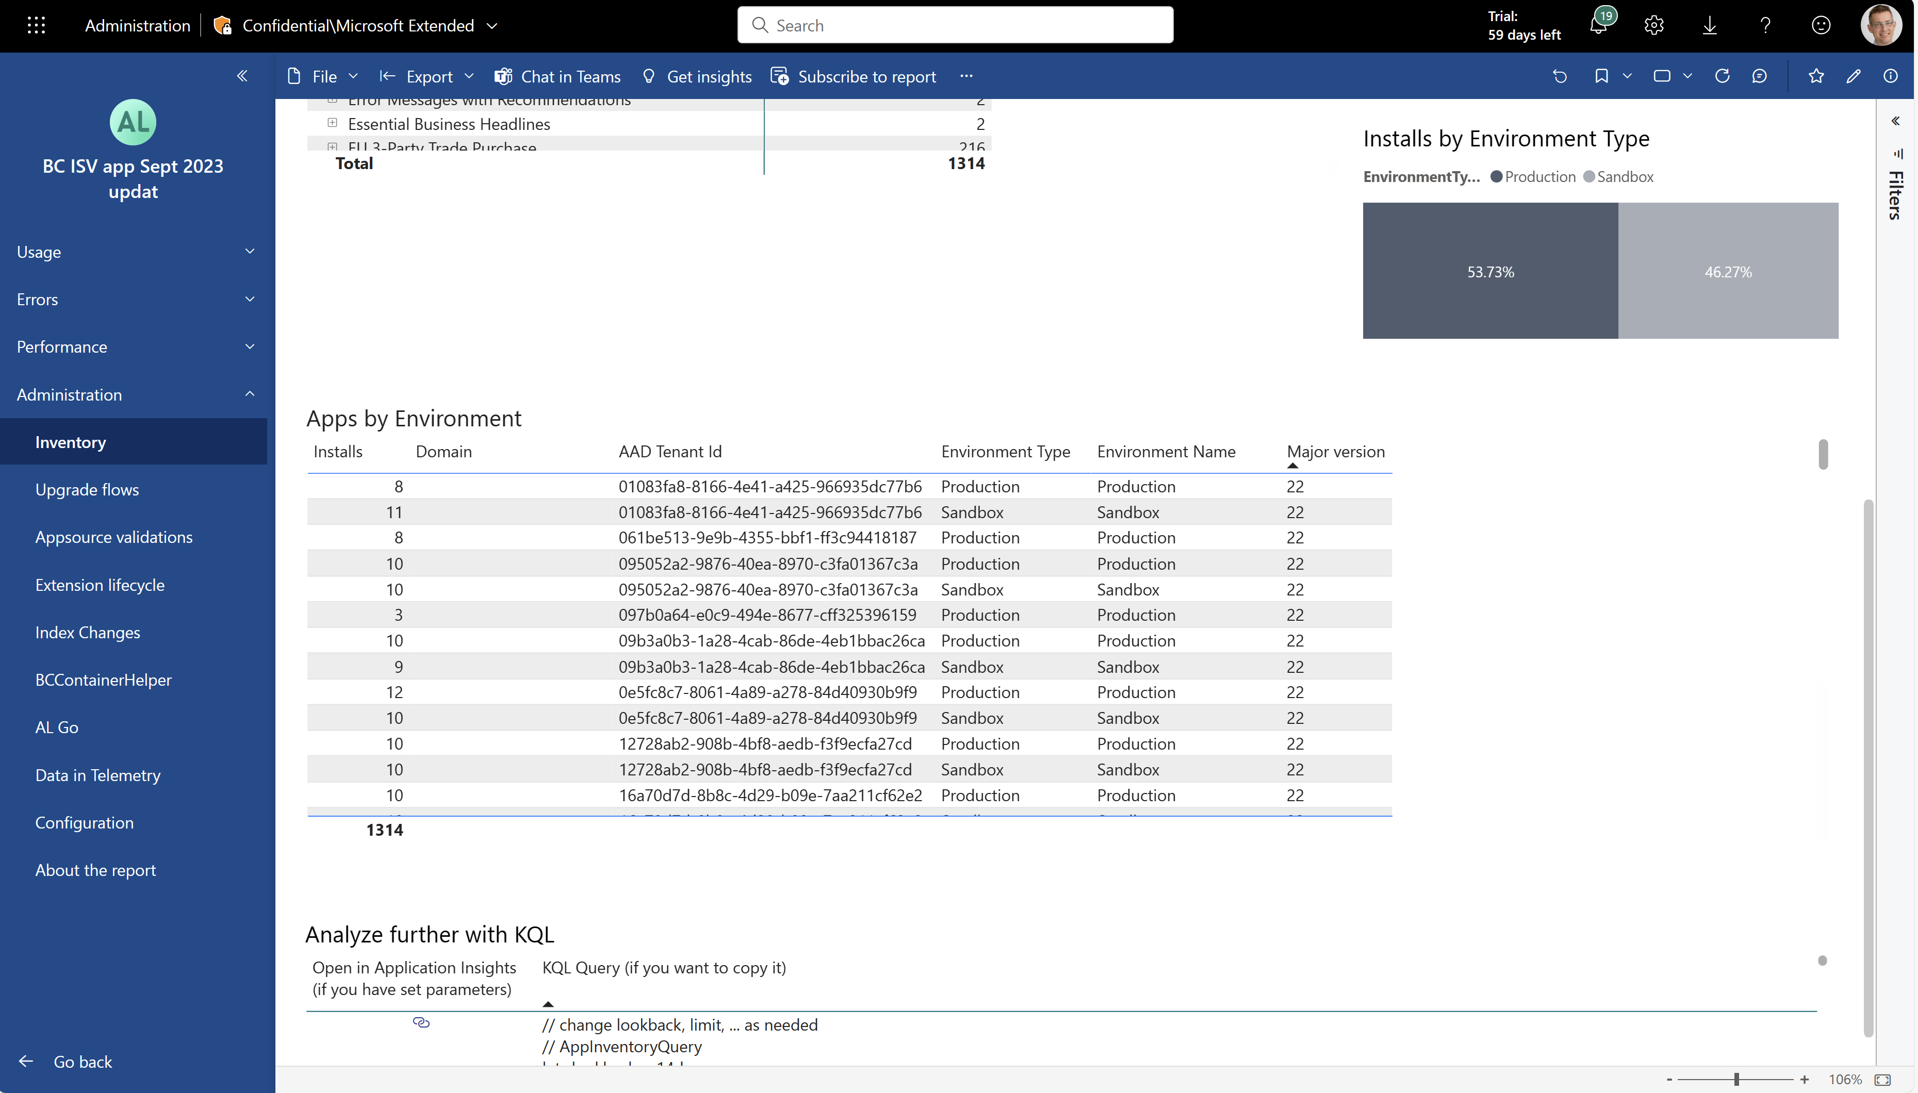
ISVs can see the major version of Business Central for their install base
Inventory report now shows major BC version for environments where your app(s) are installed

Slide 5
Get the apps from Appsource
For environment telemetry https://aka.ms/bctelemetryreport
For app telemetry https://aka.ms/bctelemetry-isv-app

